Slide 1
Advanced Project Management
Class 6: Agile Terminology & Execution Metrics

Slide 2



Class 6 Agenda
Agile Concepts
Project Boundaries
Tracking Progress
Vocabulary for iterative workflows: Agile, Sprint, Backlog.
Defining limits and outcomes: Scope, Deliverable.
Measuring success: Milestone, KPI, Stakeholder.

Slide 3
PART 1
The Agile Framework
Modern project execution vocabulary.

Slide 4
Agile & Sprint
Agile
A flexible, iterative approach to project management.
"We use an Agile approach so we can adapt to client changes quickly."
Sprint
A short, fixed time period (usually 1-4 weeks) to complete specific tasks.
"We need to finish the design phase in the next two-week sprint."
Backlog
A prioritized list of pending tasks or requirements.
"Let's move that low-priority feature to the project backlog."

Slide 5

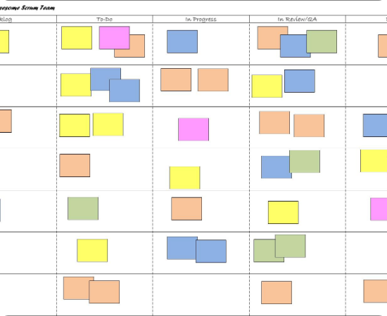
The Agile Workflow
•
Work is pulled from the Backlog.
•
Tasks are executed during a short Sprint.
•
The Agile team reviews progress daily.

Slide 6
PART 2
Boundaries & Outcomes
Defining what gets done and who cares.

Slide 7
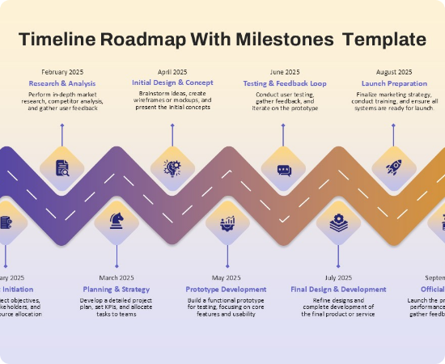
Scope & Deliverables
Scope
The defined boundaries of what the project includes (and excludes).
"Adding a mobile app is outside the current project scope."
Deliverable
A tangible output produced during or at the end of a project.
"The final financial report is our main deliverable for Q3."

Slide 8
Stakeholder
Who has an interest?
Common Stakeholders:
A Stakeholder is anyone affected by or invested in the project's outcome.
•
Clients / Customers
•
Executives (CEO, CFO)
•
Project Team Members
"We need to present this deliverable to the key stakeholders on Friday."
•
Investors

Slide 9
PART 3
Measuring Success
Tracking progress accurately.

Slide 10
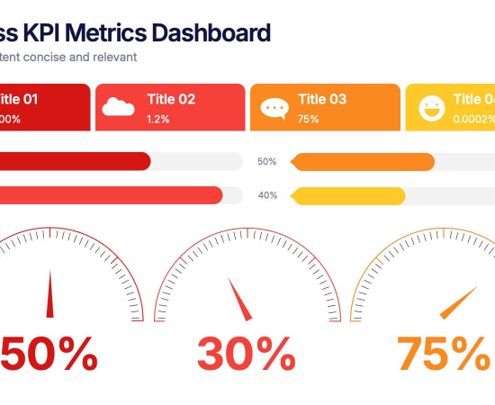
Milestone & KPI
Milestone
A key checkpoint marking significant progress in a timeline.
"Securing funding was a major milestone for our startup."
KPI
Key Performance Indicator.
A measurable value showing effectiveness toward a goal.
"Our main KPI for this campaign is website traffic growth."

Slide 11
Interactive Practice: Scenario
The Client Meeting
Read the paragraph and fill in the blanks using: Agile, Scope, Deliverable, Milestone, Stakeholders.
"Good morning. Today we are presenting the final design mockup, which is our primary ________ for this month. Reaching this design approval is a major ________ for the project. Moving forward, we will use an ________ approach, working in two-week sprints. Please note that adding new features now would change the project ________. We need all key ________ to sign off before we proceed."

Slide 12
Questions?
Review your notes and practice these terms daily.

Slide 13



Image Sources
https://blog.socketsandlightbulbs.com/wp-content/uploads/2012/02/scrum-board-example.jpg
Source: blog.socketsandlightbulbs.com
https://www.slidekit.com/wp-content/uploads/2025/01/Zig-Zag-Timeline-Roadmap-with-Milestones-PowerPoint-Template.jpg
Source: www.slidekit.com
https://stg-uploads.slidenest.com/template_4410/templateColor_4149/previewImages/business-kpi-metrics-dashboard-powerpoint-google-slides-keynote-presentation-template-1.jpeg
Source: slidenest.com

